Slide 1
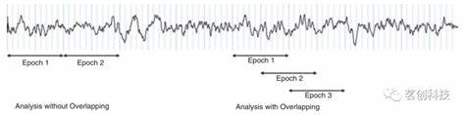
Predicting Neonatal Seizure Risk in Hypoxic-Ischemic, Encephalopathy Using EEG Metadata, Clinical Features, and Modified Sarnat Scoring
SAT 5141 - Final Project
Kameron Chung

Slide 2
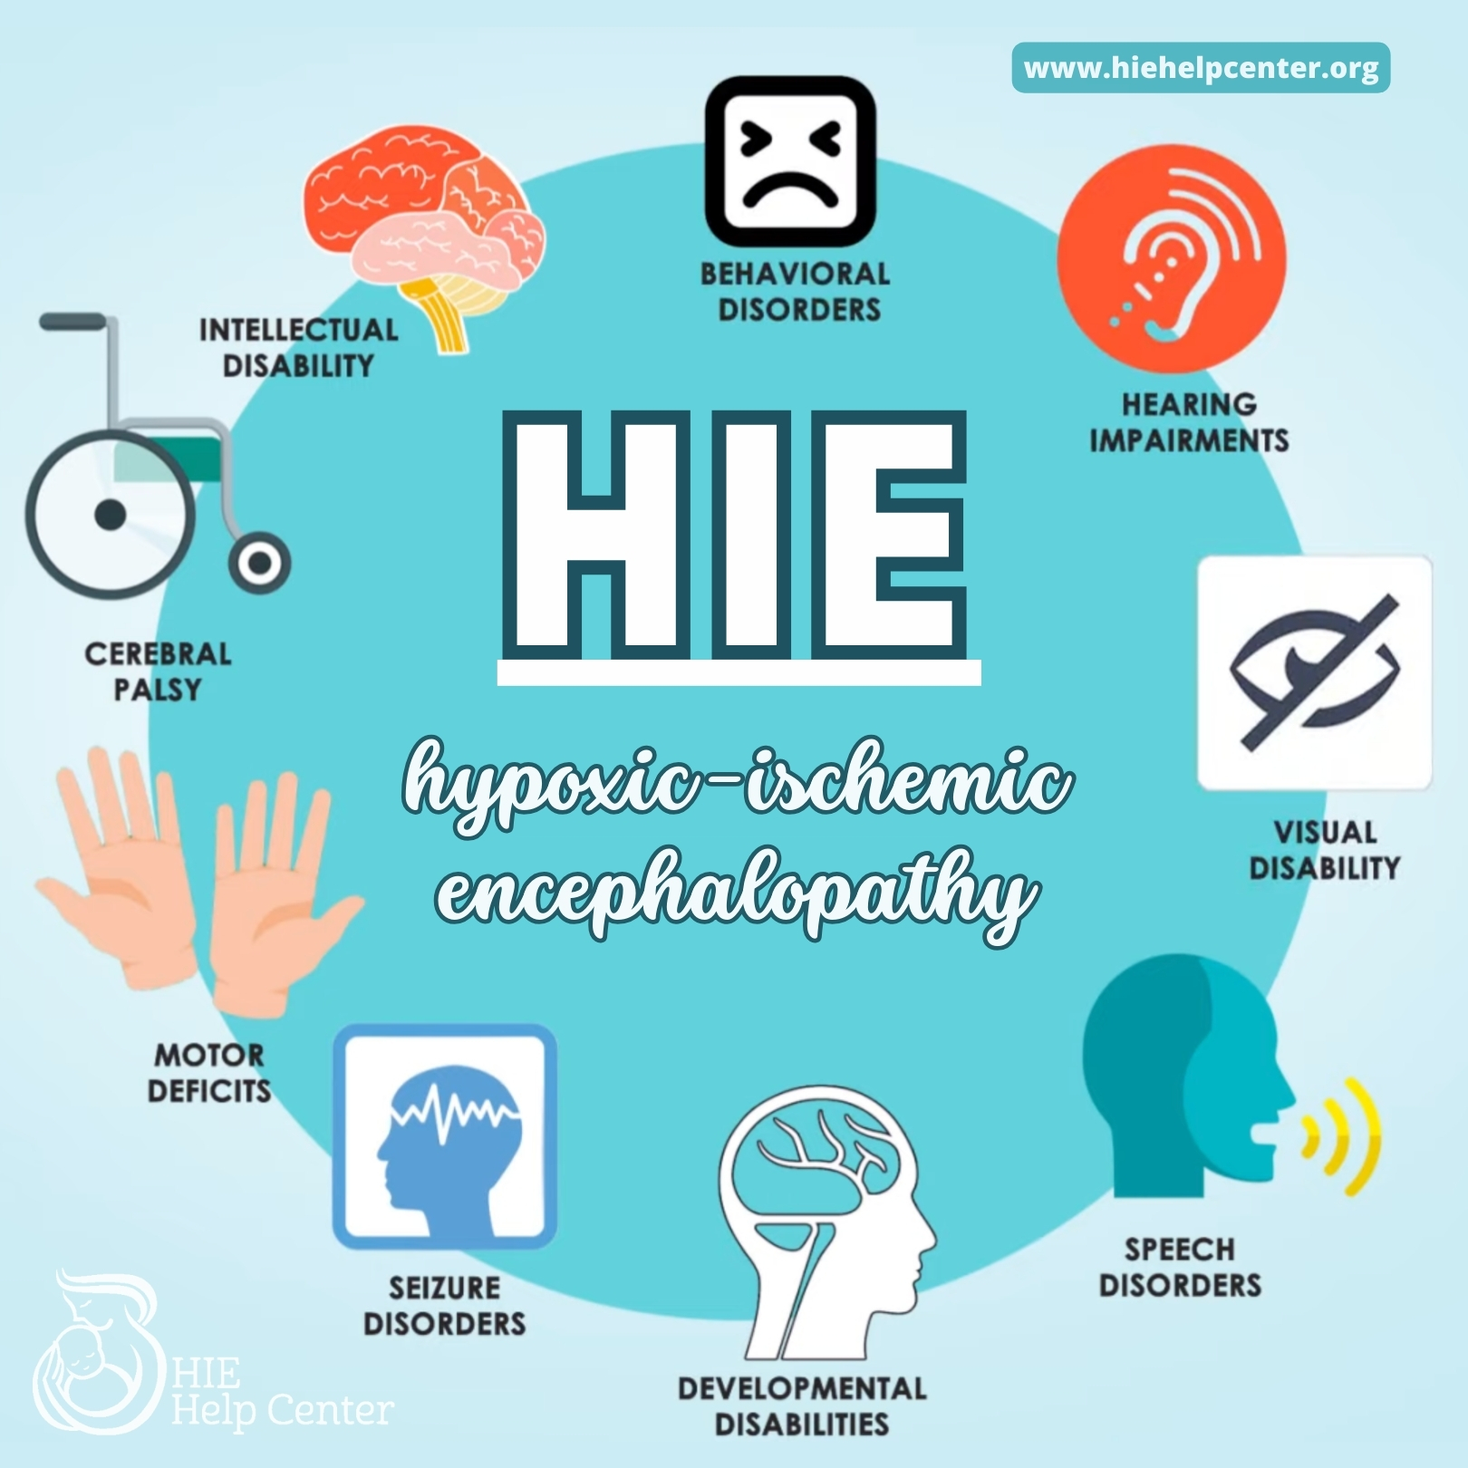
Why focus on HIE infants?
HIE occurs in 1–6 per 1,000 live term births
Leading cause of neonatal mortality and long-term disability
Subclinical seizures occur in up to 80% of neonates with HIE
Seizures worsen brain injury and are often clinically silent
Early recognition and EEG monitoring improves outcomes
High-risk, high-cost NICU population

Slide 3
Literature Review
Bonifacio & Hutson (2021): early identification of HIE is essential
Ristovska et al. (2022): high morbidity and mortality
Cornet et al. (2025): EEG background grade strongly predicts severity
Jain et al. (2017): EEG spectral features help predict neonatal seizures
Mrelashvili et al. (2020): value and challenges of Sarnat scoring
Allen & Brandon (2011): pathophysiology of injury and experimental treatments
Babbo et al. (2024): cost and long-term burden of neonatal encephalopathy

Slide 4
Costs and Burdens of HIE
Hospital cost of severe HIE case: $70,000–150,000+
Long-term costs for CP/epilepsy: >$1 million lifetime
Prolonged NICU stay and neuroimaging use
Seizures increase:
  length of stay
  probability of neurodevelopmental disability
  resource utilization

Slide 5
Population Identification Codes
ICD-10 Codes for HIE:
P91.60 (Unspecified HIE)
P91.61 (Mild)
P91.62 (Moderate)
P91.63 (Severe)
Seizure-related codes:
P90 (Neonatal convulsions)
Procedures:
Continuous EEG monitoring
MRI/cranial ultrasound

Slide 6
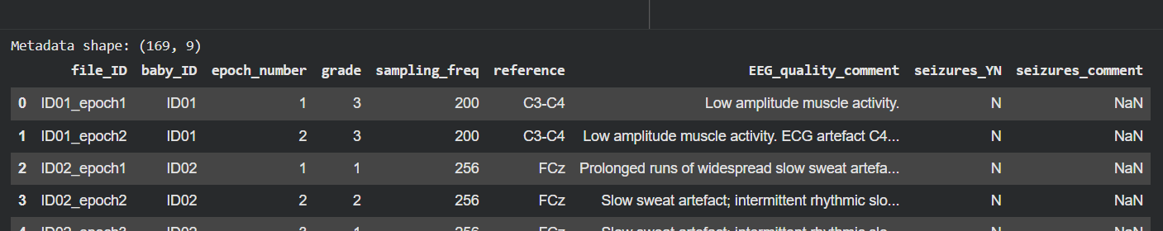
Measurement and Data Sources
Two datasets:
  EEG Metadata dataset
  Clinical Information dataset
Primary measurement:
  Predicting seizure occurrence from EEG metadata
Secondary measurement:
  Predicting seizures using only clinical factors
Tertiary tool
  Modified Sarnat score calculator

Slide 7
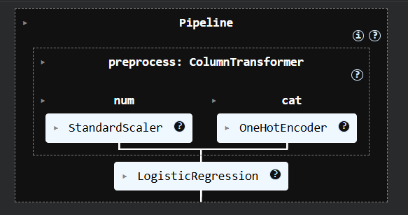
Why logistic regression?
Transparent, interpretable model
Works well for low-feature datasets
Allows threshold tuning
Suitable for imbalanced datasets with oversampling
Alternative models considered:
  Random Forest
  Gradient Boosting
  1D CNN for raw EEG (future direction)

Slide 8
Strengths and Weaknesses of the Data
Strengths
  Real NICU EEG data
  Annotated by trained experts
  Includes both background grade and seizure labeling
Weaknesses
  Only 2 infants with seizures in metadata dataset
  Small sample sizes → limited generalizability
  No raw EEG waveforms for feature extraction
Risk Adjustment / Severity Adjustment
  Used Sarnat scoring tool
  Patient-wise train-test split to avoid leakage
  Oversampling in training set

Slide 9
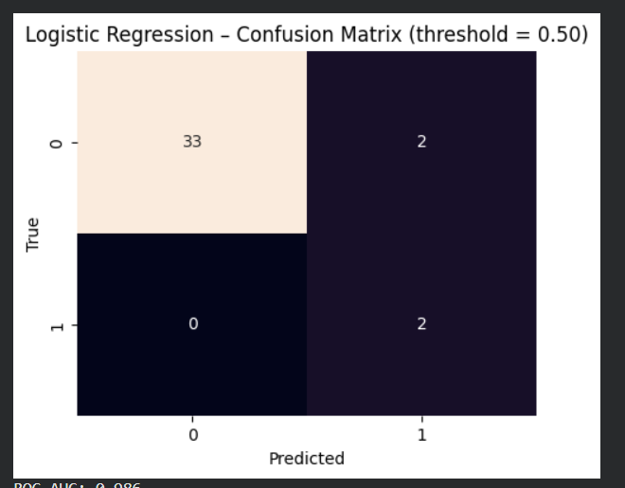
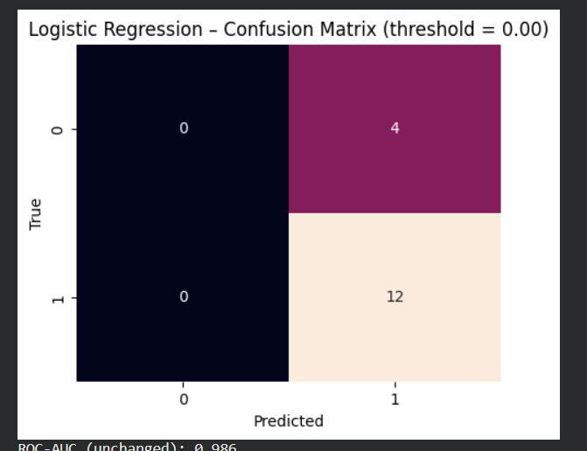
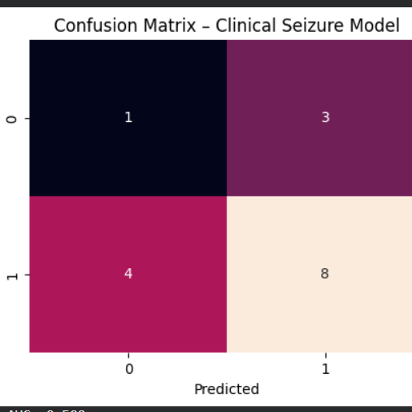
Model findings and Interpretations
EEG metadata model predicted seizures better than clinical-only model
Threshold tuning improved sensitivity/reduced false negatives
Clinical-only model performed near chance
Sarnat tool provides structured context for EEG monitoring decisions

Slide 10
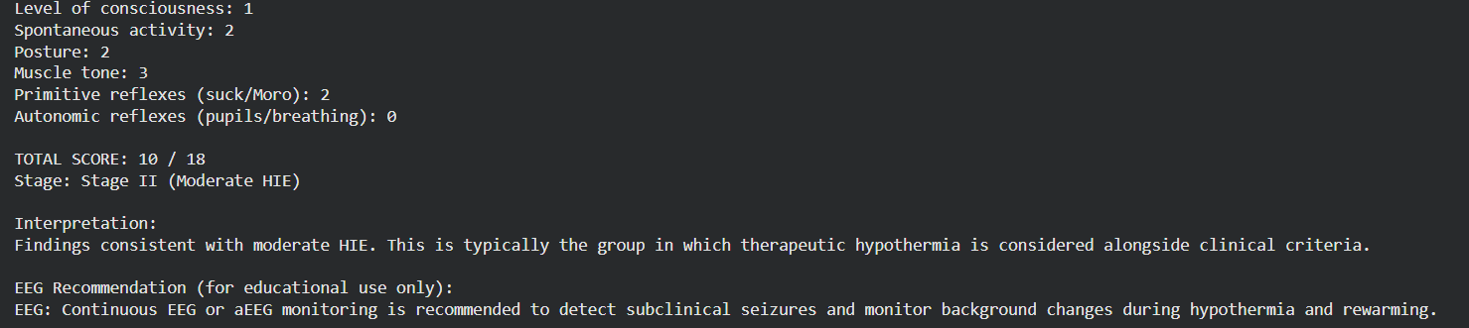
Recommendations and Feasability
Recommendations:
Use larger datasets or merge multiple NICU EEG datasets
Include raw EEG features or deep learning models
Integrate Sarnat scoring into structured EHR documentation
Develop a CDS interface that combines:
  EEG risk model
  Sarnat stage
  Clinical risk factors
Feasibility:
Technically feasible with larger datasets
Clinically relevant—low-risk to integrate decision support
Regulatory work needed before deployment

Slide 11
Conclusion
EEG information is essential for predicting seizures in HIE
Logistic regression with oversampling provides a starting point
Clinical variables alone cannot reliably detect risk
The Modified Sarnat calculator adds interpretability and clinical structure
Future work: multimodal CDS platform combining EEG + clinical scoring

Slide 12
References
Allen, K. A., & Brandon, D. H. (2011). Hypoxic Ischemic Encephalopathy: Pathophysiology and
Experimental Treatments. Newborn and infant nursing reviews : NAINR, 11(3), 125–133.
https://doi.org/10.1053/j.nainr.2011.07.004
Babbo, C. C., Mellet, J., van Rensburg, J., Pillay, S., Horn, A. R., Nakwa, F. L., Velaphi, S. C.,
Kali, G. T. J., Coetzee, M., Masemola, M. Y. K., Ballot, D. E., & Pepper, M. S. (2024).
Neonatal encephalopathy due to suspected hypoxic ischemic encephalopathy:
pathophysiology, current, and emerging treatments. World journal of pediatrics : WJP,
20(11), 1105–1114. https://doi.org/10.1007/s12519-024-00836-9
Bonifacio, S. L., & Hutson, S. (2021). The Term Newborn: Evaluation for Hypoxic-Ischemic
Encephalopathy. Clinics in perinatology, 48(3), 681–695. https://doi.org/10.1016/j.clp.2
021.05.014
Cornet, M. C., Numis, A. L., Monsell, S. E., Chan, N. H., Gonzalez, F. F., Comstock, B. A., Juul,
S. E., Wusthoff, C. J., Wu, Y. W., & Glass, H. C. (2025). Assessing Early Severity of
Hypoxic-Ischemic Encephalopathy: The Role of Electroencephalogram Background in
Addition to Sarnat Exam. The Journal of pediatrics, 277, 114411.
https://doi.org/10.1016/j.jpeds.2024.114411

Slide 13
References cont.
Jain, S. V., Mathur, A., Srinivasakumar, P., Wallendorf, M., Culver, J. P., & Zempel, J. M. (2017).
Prediction of Neonatal Seizures in Hypoxic-Ischemic Encephalopathy Using
Electroencephalograph Power Analyses. Pediatric neurology, 67, 64–70.e2. Https
://doi.org/10.1016/j.pediatrneurol.2016.10.019
O'Toole, J. M., Mathieson, S. R., Magarelli, F., Marnane, W. P., Lightbody, G., & Boylan, G. B.
(2022). Neonatal EEG Graded for Severity of Background Abnormalities (2.0) [Data set]. Zenodo. https://doi.org/10.5281/zenodo.7477575
Mrelashvili, A., Russ, J. B., Ferriero, D. M., & Wusthoff, C. J. (2020). The Sarnat score for
neonatal encephalopathy: looking back and moving forward. Pediatric research, 88(6),
824–825. https://doi.org/10.1038/s41390-020-01143-5
Ristovska, S., Stomnaroska, O., & Danilovski, D. (2022). Hypoxic Ischemic Encephalopathy
(HIE) in Term and Preterm Infants. Prilozi (Makedonska akademija na naukite i
umetnostite. Oddelenie za medicinski nauki), 43(1), 77–84. https://doi.org/10.2478/prilo
zi-2022-0013
Stevenson, N., Tapani, K., Lauronen, L., & Vanhatalo,S. (2018). A dataset of neonatal EEG
recordings with seizures annotations [Data set]. Zenodo. https://doi.org/10.5281/zenodo.4940267

Slide 14
Thank you!

